Slide 1

Inconometrics
Prediction of Income using Naive Bayes
Presented By:
Ajay Deshmukh
Darshan Bhansali
Vishwadeep Dutta
Notes:
Econometrics is the quantitative application of statistical and mathematical models using data to develop theories or test existing hypotheses in economics and to forecast future trends from historical data.

Slide 2
Introduction
Inconometrics is a digital marketing company.
It recommends products to customer based on their data.
Recently they are in need to predict the salary of the customers.
So that they can send customized product recommendations.
They want to categorized the customers based on their salary
If predicted salary is greater than 50k : Suggest premium products
If less than 50k: Economical products

Slide 3
How to recommend?
How to predict salary?

Slide 4
Solution
Applying Naive bayes algorithms to predict Salary

Slide 5

In machine learning, naïve Bayes classifiers are a family of simple "probabilistic classifiers" based on applying Bayes' theorem with strong (naïve) independence assumptions between the features.
^{Naive Bayes}
This algorithm is called “Naive” because it makes a naive assumption that each feature is independent of other features which is not true in real life.

Slide 6
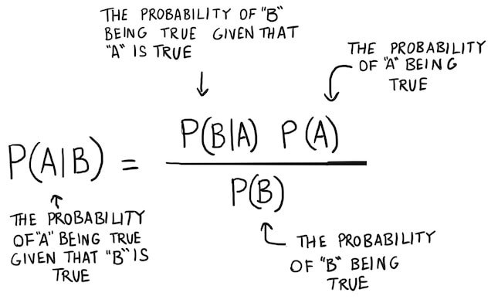
Bayes Theorem
Notes:
Bayes’ Theorem finds the probability of an event occurring given the probability of another event that has already occurred.
Basically, we are trying to find probability of event A, given the event B is true. Event B is also termed as evidence.
P(A) is the priori of A (the prior probability, i.e. Probability of event before evidence is seen). The evidence is an attribute value of an unknown instance(here, it is event B).
P(A|B) is a posteriori probability of B, i.e. probability of event after evidence is seen.

Slide 7

Bayesian ML Models Used
Multinomial Naive Bayes - scikit-learn
Categorical Naive Bayes- scikit-learn
Gaussian Naive Bayes- scikit-learn
Multinomial Naive Bayes - Spark-ML

Slide 8
Data Description
Number of records: 48562
Number of columns: 15
Metadata
age | Integer | Continuous
Workclass | String | Categorical
fnlwgt | Integer | Continuous
Education | String | Categorical
education_num | Integer | Continuous
marital_status | String | Categorical
occupation | String | Categorical
relationship | String | Categorical
race | String | Categorical
gender | String | Categorical
capital_gain | Integer | Continuous
capital_loss | Integer | Continuous
hours_per_week | Integer | Continuous
native_country | String | Categorical
income_bracket | String | Categorical
Notes:
we have 15 columns
MOst of them have categorical values but there are few columns with continuous values
We are going to convert the continuous values to categorical values using sliding windows For example we are going to make 4 categories for age group.
We are going to drop the capital gain and capital loss columns because it has mostly zero values which is of no use.
the education-num columns is derived from Education column. In naive bayes we consider all the features to be independent variables thus to normalize the weightage of the column, we are dropping it.

Slide 9
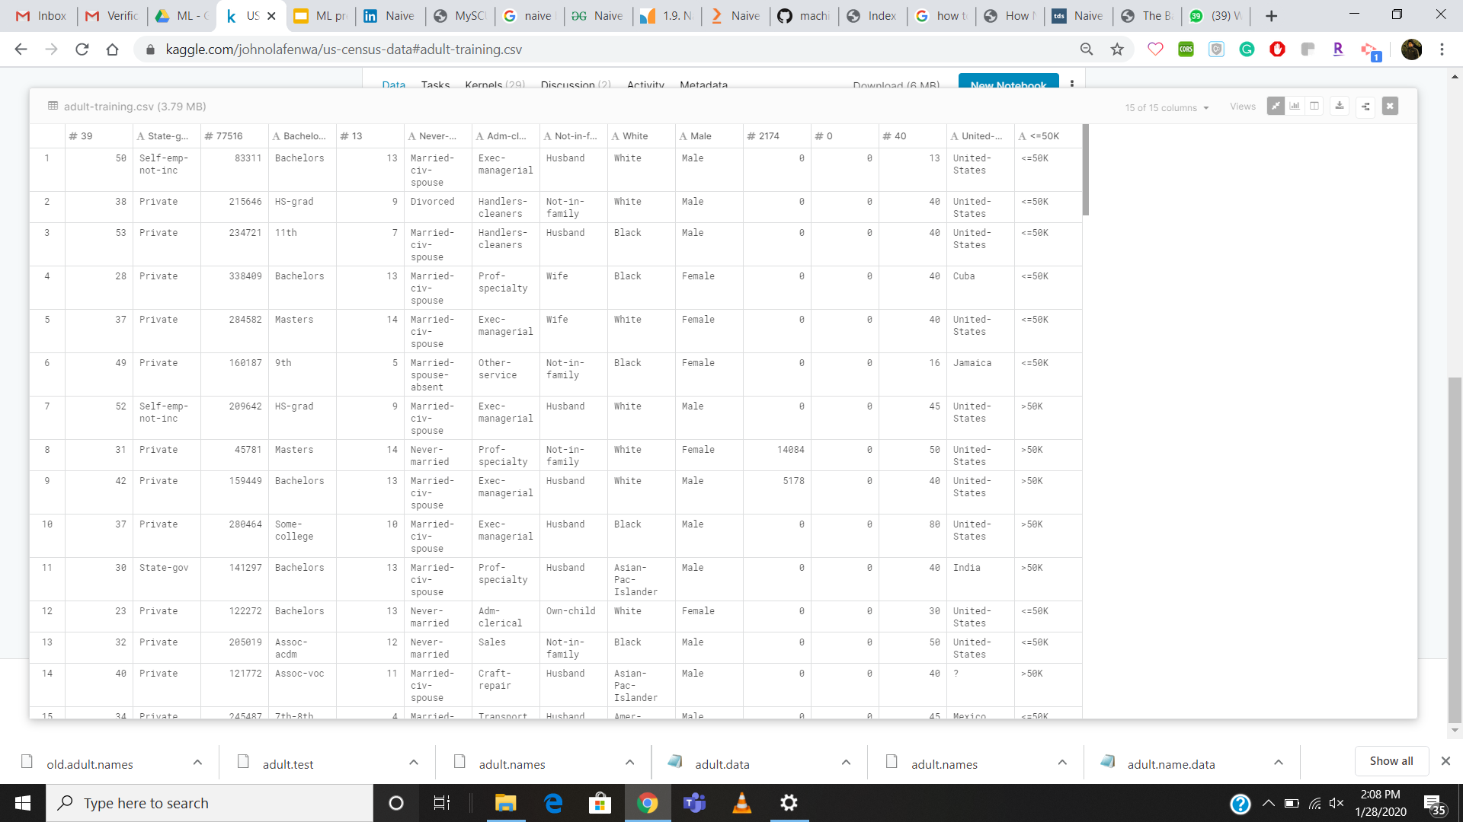
Data

Slide 10
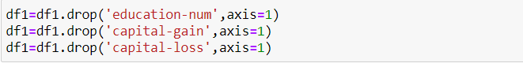
Data Cleaning
Dropped the unwanted columns:
education-num
capital-gain
capital-loss
Notes:
More than 44000 values are zero in capital-gain
capital-loss- 46000
and

Slide 11
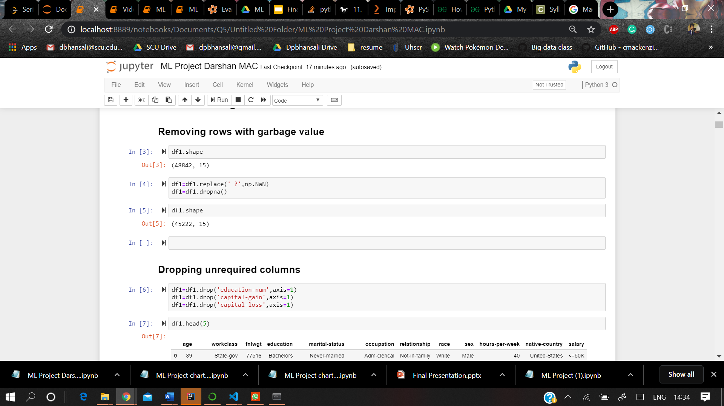
Removing the Garbage Values

Slide 12
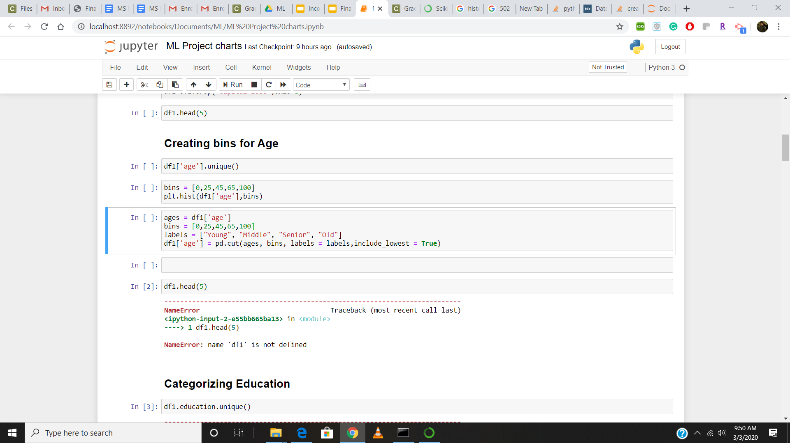
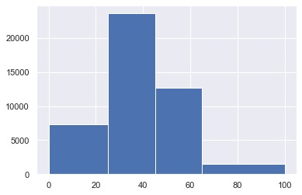
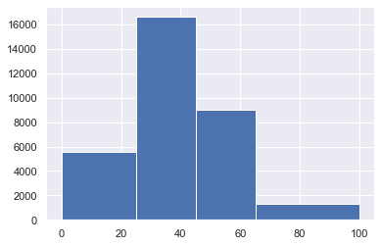
Creating Bins for Age
Since here the age was in a discrete form so for Naive bayes we need to categorize it in the form of bin.

Slide 13
Categorizing the fields
The following fields have been categorized:
education
marital-status
occupation
native country
workclass

Slide 14
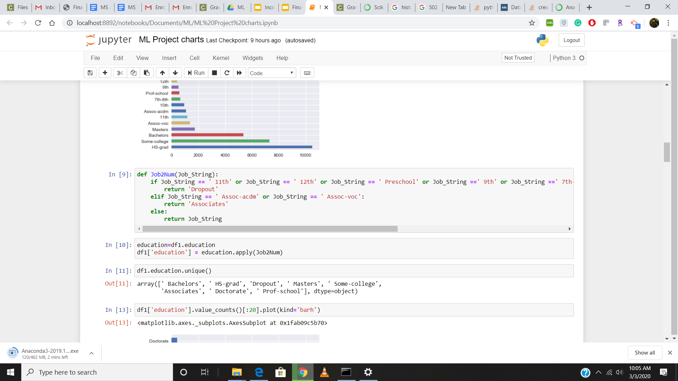
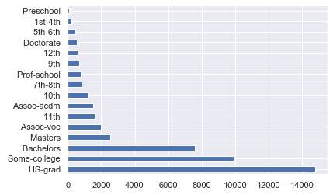
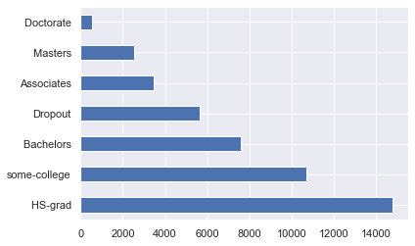
Categorizing Education
Add Graphs
Notes:
before 16
after 7

Slide 15
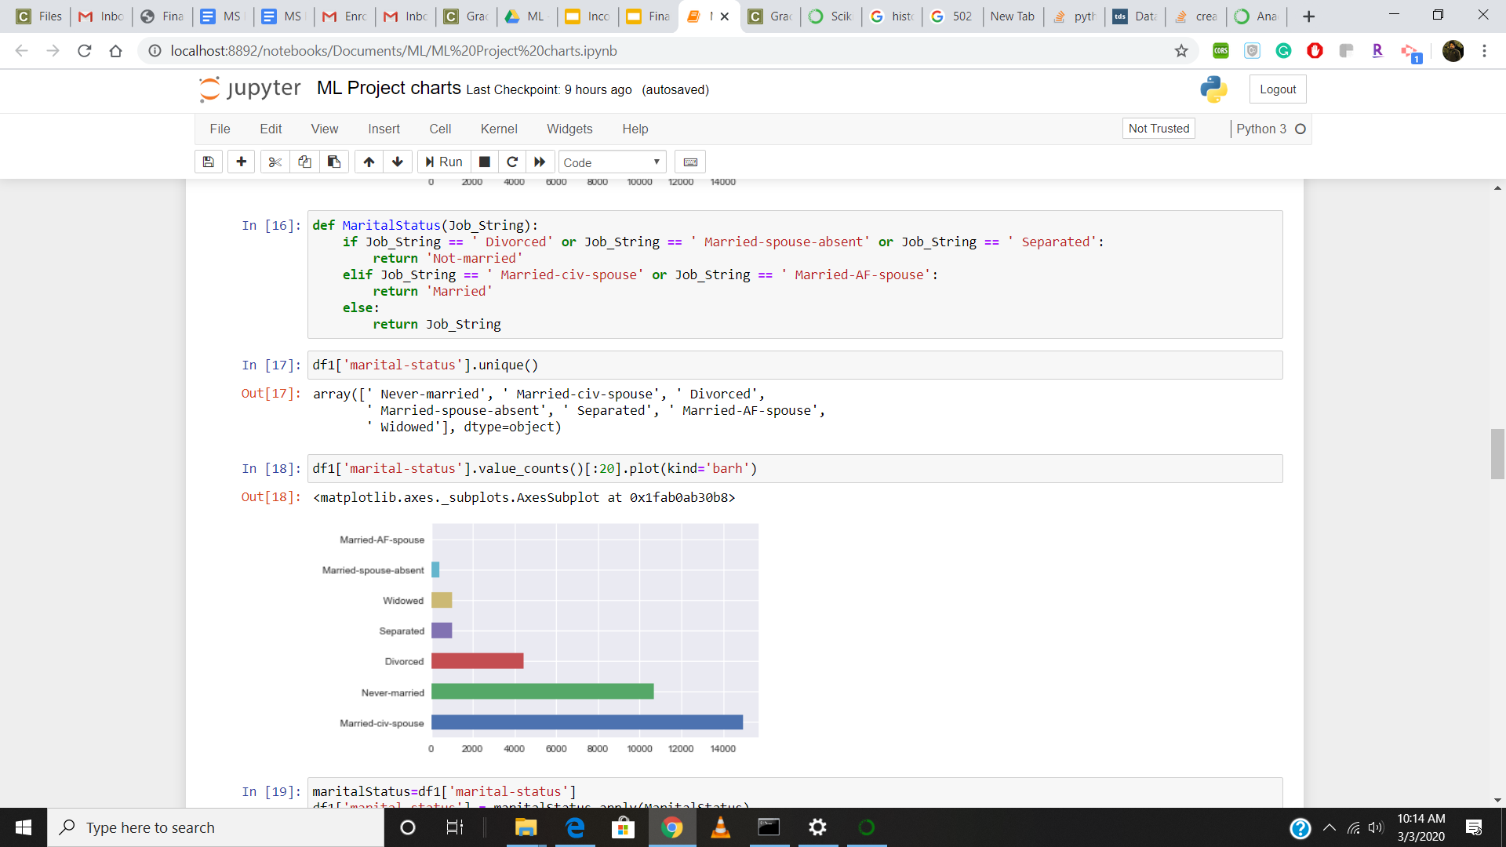
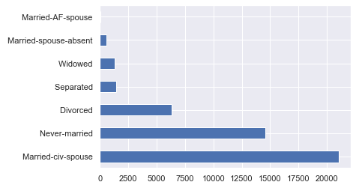
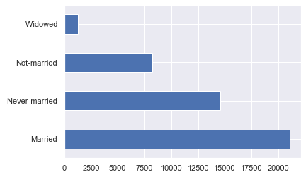
Categorizing Marital Status
Before and after graph
Notes:
before 7
after 4

Slide 16
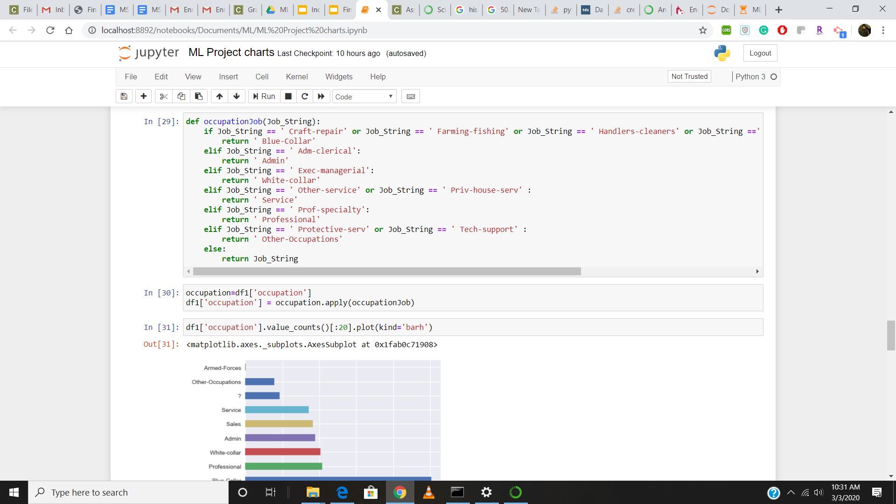
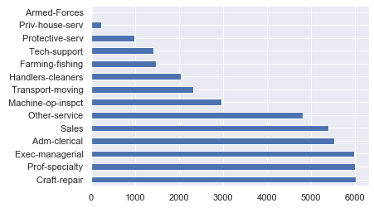
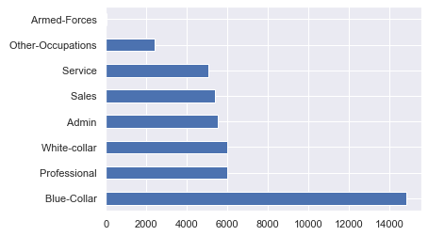
Categorizing Occupation
Notes:
before 14
after 8

Slide 17
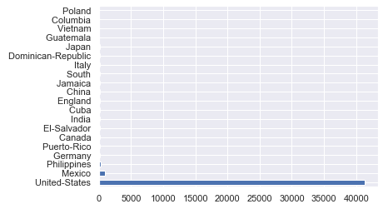
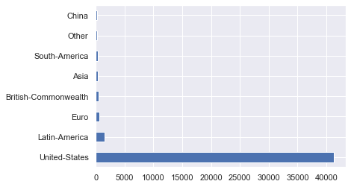
Categorization Of Country

Slide 18
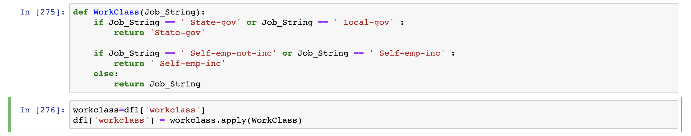
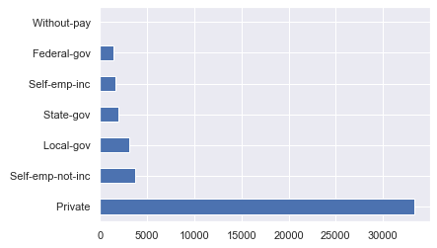
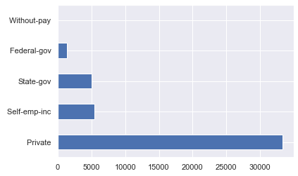
Categorization of Workclass
Categorizing workclass

Slide 19
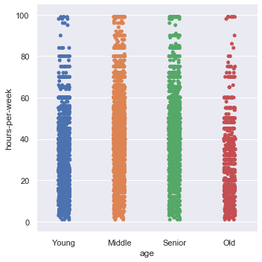
Some Small conclusions from Chart ?
This graph depicts young and old people doesn’t work more than 40 hours as compared to middle and senior age people.

Slide 20
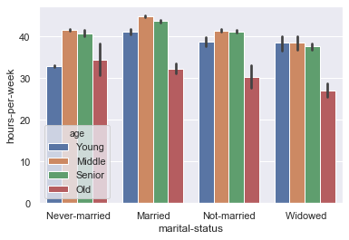
This graph shows the correlation between the marital status, hours-per-week and age.
And it can be said that here also Middle and Senior aged people are working more than 40 hours in all types of Marital status.

Slide 21
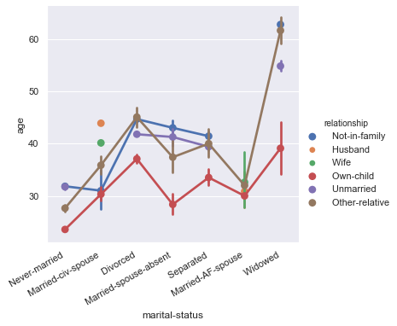
This graphs depicts that out dataset consist of most people belonging to mid 30’s and 40’s.
And also they are either married or divorced or have someone dependent on them, and also from the previous slide we can say that this age group works more than 40 hours.

Slide 22
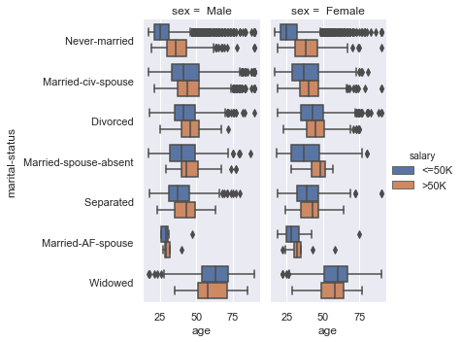
This charts show a small finding from the dataset describing the age bracket of each marital status for both the gender. And also further classifying it salary above 50k and less than 50k.

Slide 23
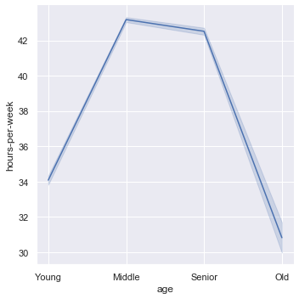
This graph shows the similar correlation between age hours-per-week.

Slide 24
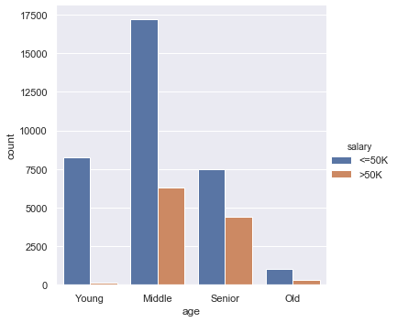
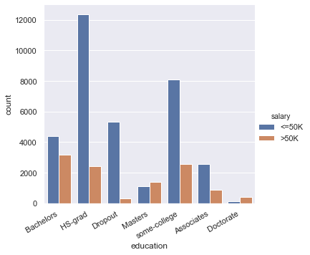
These charts depicts the Salary correlation with Age and education

Slide 25
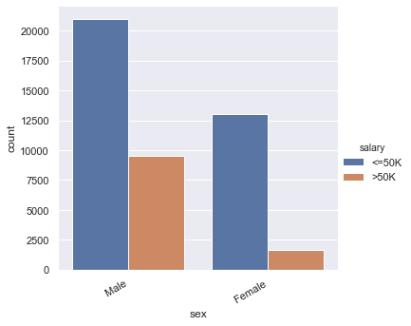
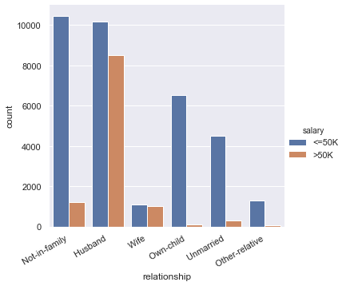
These charts depicts the Salary correlation with Gender and Relationship

Slide 26
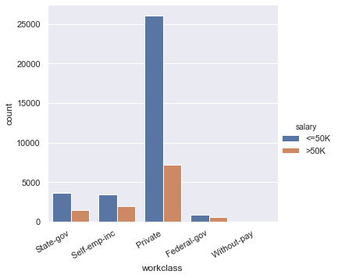
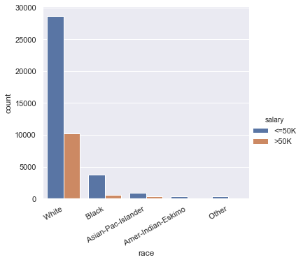
These charts depicts the Salary with workclass and race.

Slide 27
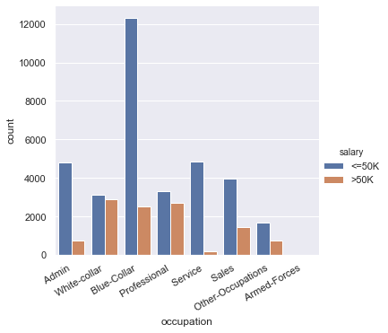
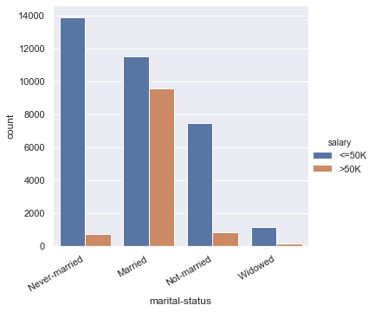
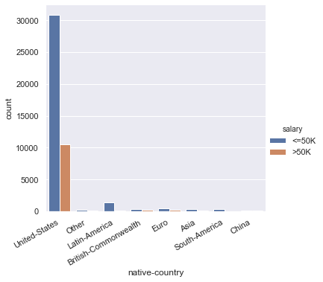
These charts depicts the Salary correlation with occupation, marital status and country

Slide 28
ML Models
Notes:
Metrics computed from a confusion matrix
-Classification Accuracy: percentage of correct predictions
-Classification Error: percentage of wrong prediction
-Sensitivity: When the actual value is positive
-Specificity: When the actual value is negative
-Precision:When a positive value is predicted,
-

Slide 29
Gaussian Naive Bayes: Sklearn
Algorithm Summary:
Tasks: Classification with categorical and continuous variables.
Gaussian Naive Bayes is best suited for continuous data.
It can also be applied on categorical data.
Assumption:
Data should be of Gaussian Distribution
Notes:
Trying and learning and adapting is the reason why we implemented machine learning
Our dataset has a combination of categorical and continuous values

Slide 30
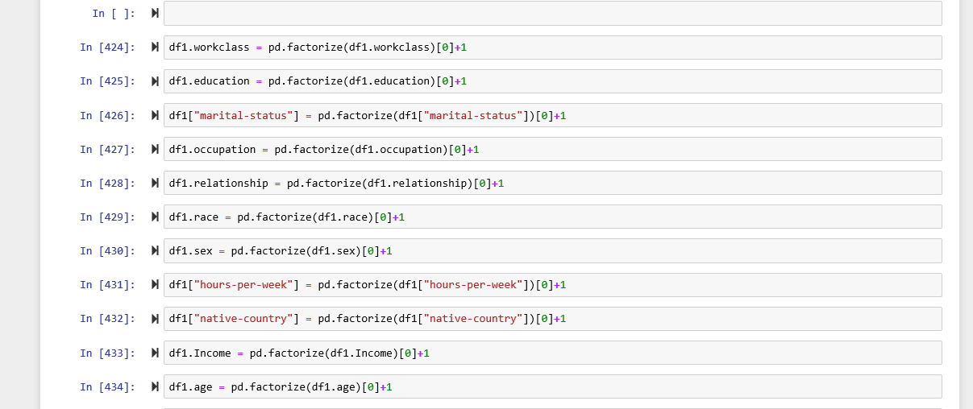
Approach
Converted the categorical data into continuous integer data.
Verified through charts that some of the features follow gaussian distribution (Marital Status, education, work class and occupation).
Dropped the column of ‘fnlwgt’ because the column neither has categorical data nor does the continuous data follow a gaussian distribution.

Slide 31
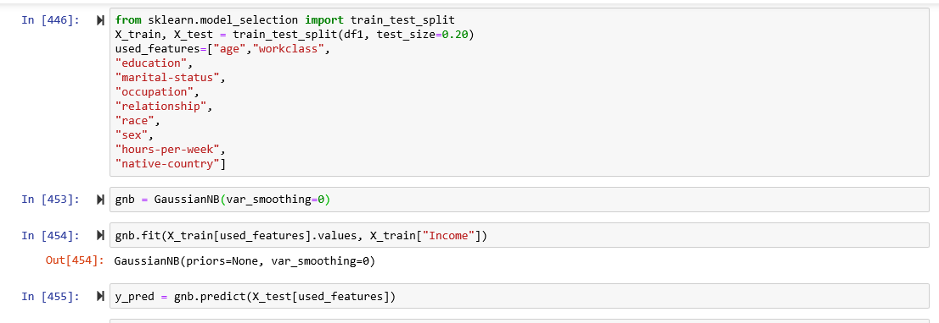
Split the given dataset into training and test dataset in the ratio of 80:20.
Created a Gaussian Naive Bayes Classification Model without the var_smoothing.

Slide 32
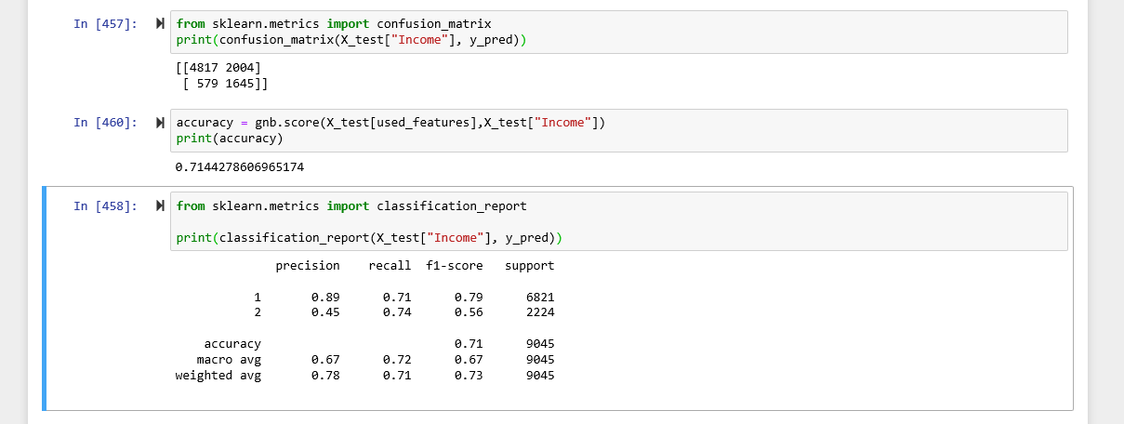
Evaluation
Used confusion matrix to evaluate the model.
Calculated the accuracy using the confusion matrix which comes out to be 71.44%.
Developed a classification report to analyze the results.
Precision: 0.89
Recall: 0.71
Notes:
Precision: “When it predicts the positive result, how often is it correct?”
Recall: “When it predicts the positive result, how often is it correct?”
f1-score: this is just the harmonic mean of precision and recall

Slide 33
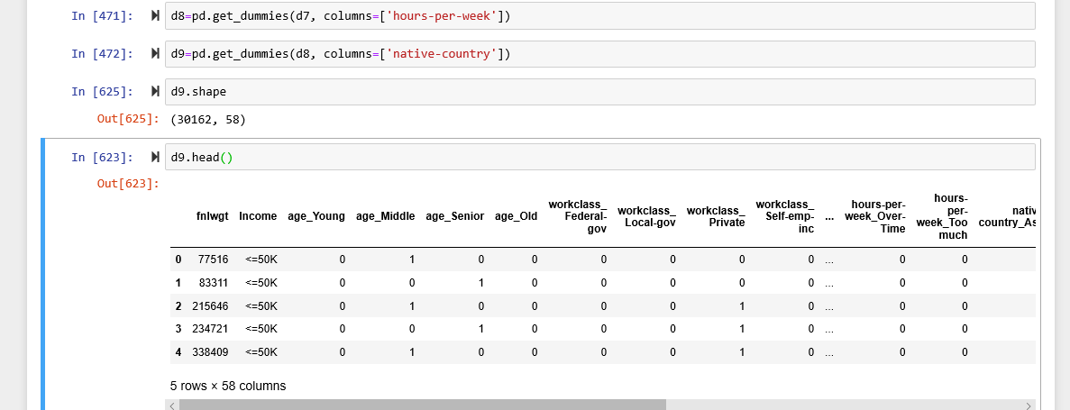
Multinomial Naive Bayes - scikit-learn
Approach:
Categorized features like age, education, occupation etc to reduce the dimensionality.
Converted the categorical data into discrete binary values for each feature.
Used One-hot encoding to manipulate the data to create binary values for each feature category.

Slide 34
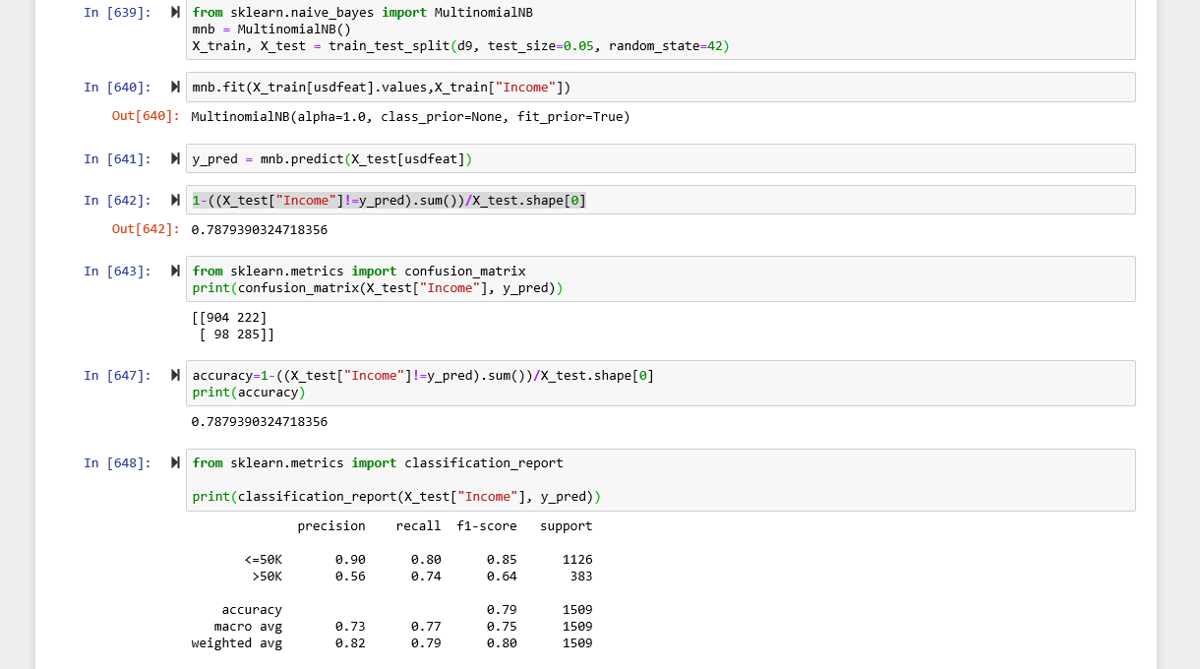
Model fitting and Evaluation
Notes:
Precision: “When it predicts the positive result, how often is it correct?”
Recall: “When it predicts the positive result, how often is it correct?”
f1-score: this is just the harmonic mean of precision and recall

Slide 35
Evaluation
Used confusion matrix to evaluate the model.
The accuracy of the categorical model using the confusion matrix is 78.7%.
Developed a classification report to analyze the results.
Precision: 0.90
Recall: 0.80

Slide 36
Categorical Naive Bayes
Algorithm Summary:
CategoricalNB by scikit-learn is a new class to be added in the naive_bayes module.
CategoricalNB implements the categorical naive Bayes algorithm for categorically distributed data.
It considers the most basic assumption of the Naive Bayes i.e. features have discrete and categorical values.
CategoricalNB assumes that the sample matrix X is encoded (for instance with the help of OrdinalEncoder) such that all categories for each feature are represented with numbers 0 to n_{i}-1 where n_{i} is the number of available categories of feature i.

Slide 37
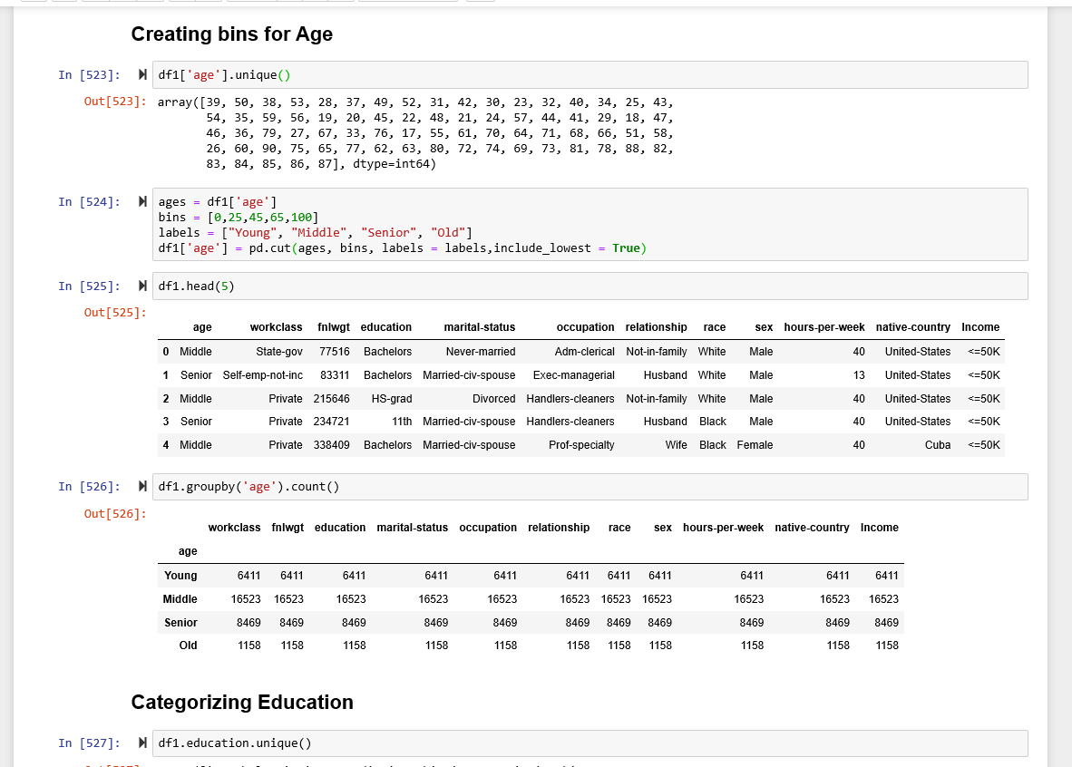
Approach
Categorizied columns like age, workclass, education, marital status, occupation, Native country and hours per week to better categorize the parameters and reduce dimensionality.
Notes:
Created bins for ages and hours per week,

Slide 38
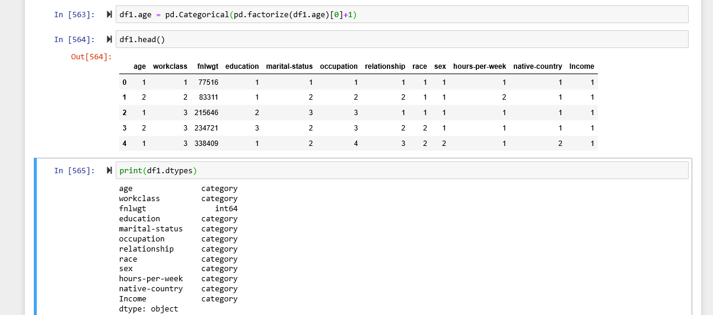
Approach
Converted the categorical data into categorical integer data.
Dropped the column of ‘fnlwgt’ because the column does not have categorical data.
Notes:
Observe that the values are integers but the data types are categorical.

Slide 39
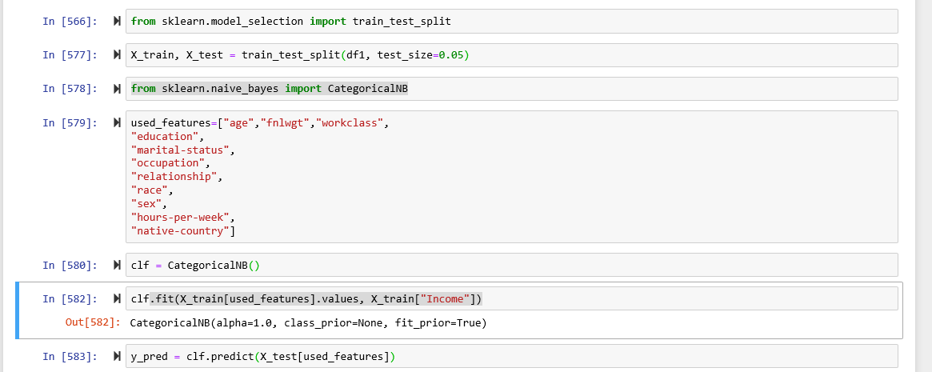
Model Fitting
Split the given dataset into training and test dataset in the ratio of 80:20.
Created a Categorical Naive Bayes Classification Model.

Slide 40
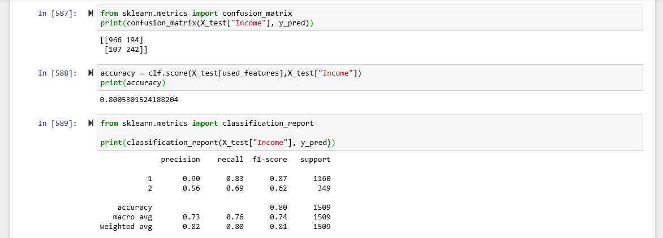
Evaluation
Used confusion matrix to evaluate the model.
The accuracy of the categorical model using the confusion matrix is 80.05%.
Developed a classification report to analyze the results.
Precision: 0.9
Recall: 0.83

Slide 41
Multinomial Naive Bayes : Spark ML
Algorithm Summary
Task: Classification with binary or multiclass labels
Input: Labels (binary or multiclass, 0-based indexed), feature vectors (discrete)
Model type: Multinomial (default)
Assumptions:
Independence between every pair of features
Feature values are nonnegative, such as counts
Notes:
Multinomial means having multiple classes to predict.
In our project we are predicts 2 classes of salary whether it is greater than 50k or not;
Here the input will be lebels which means classes to be predicted (>50 k or <50k), and a feature vetor which contains data of all the columns which are going to be used to predict the salary.

Slide 42
Approach
Created a SQL table from pandas dataframe
Selected columns to fit in the algorithm
Splitted the data into test and train data set
Converted the data into numerical categories
Used the VectorAssembler() to merge our feature columns into a single vector column.
Create a Multiclass Naive Bayes Classifier

Slide 43
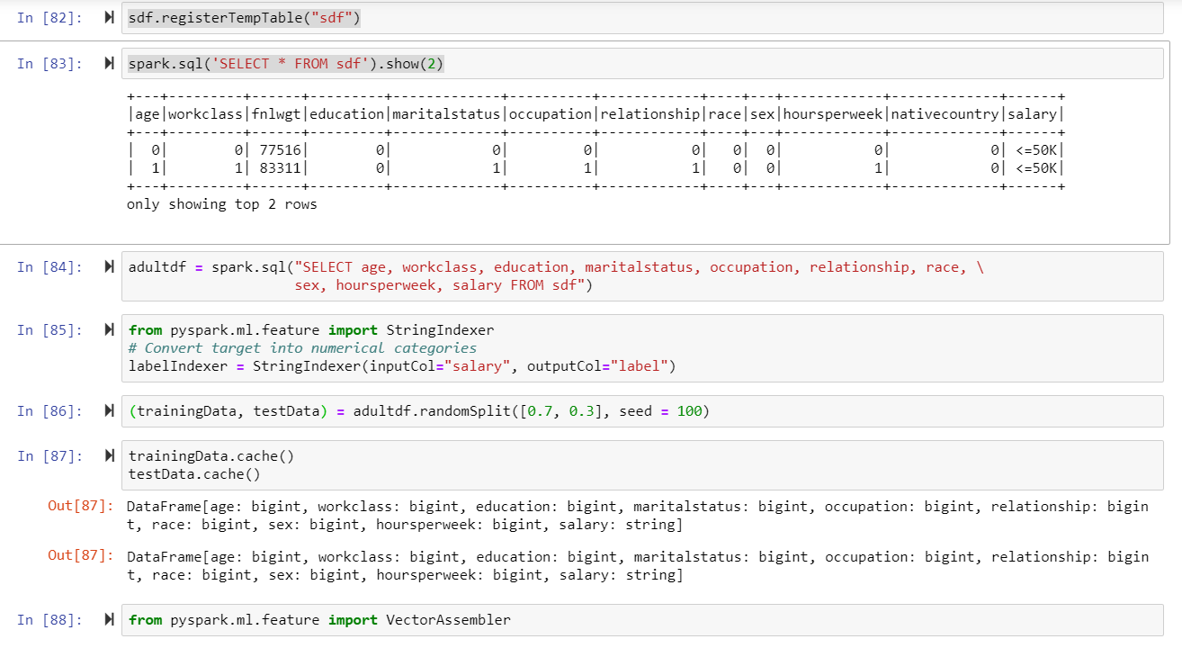

Slide 44
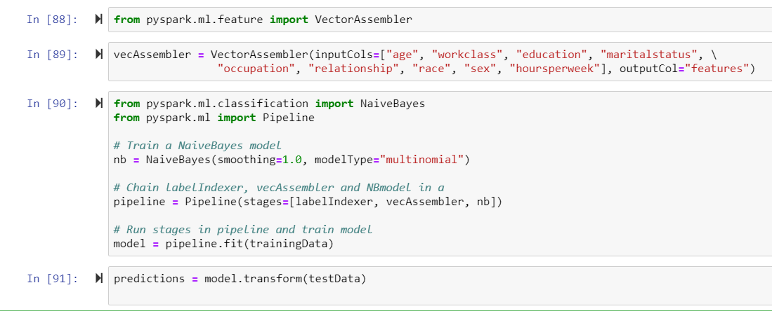

Slide 45
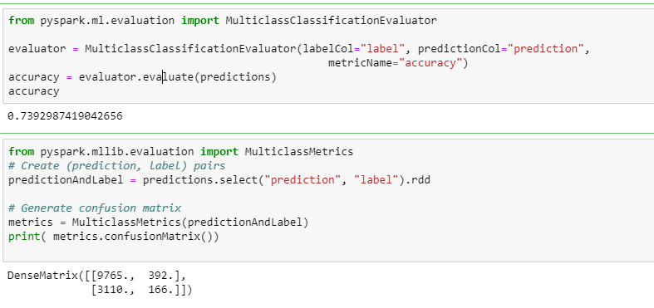
Evaluation
Notes:
confusionMatrix() returns a DenseMatrix with the columns representing the predicted class ordered by ascending class label, and each row represents the actual class ordered by ascending class label. The diagonal from top left to bottom right represents the observations that were predicted correctly.

Slide 46
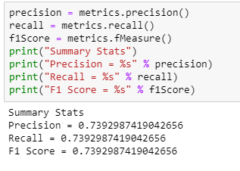
Evaluation using different metrics
Metrics used:
Result: By evaluating results of different merices, we can say that out model appx. 74% accurate.

Slide 47
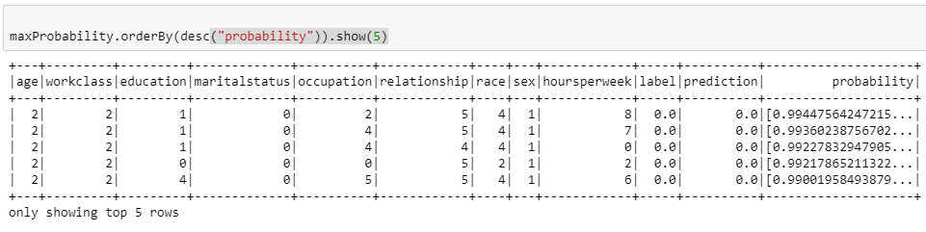
Useful Insights from the model
By analyzing model’s output we can say that people with senior age group (45 to 65 ), private workclass, education Masters, marital status being never married (Assumption: Workaholic ) , and sex male are having maximum probability of earning more than 50K.

Slide 48
Conclusion
Model Summary:
Gaussian Model Scikit-learn: 71.44%
Multinomial Model Spark ML: 73.9%
Multinomial Model Scikit-learn:78.7%
Categorical Model Scikit-learn: 80.05%
By analyzing results of the above mentioned algorithm, we have decided to use Categorical Naive Bayes Model to predict the salaries because it has highest accuracy.

Slide 49
References
https://www.kaggle.com/johnolafenwa/us-census-data
https://archive.ics.uci.edu/ml/datasets/census+income
https://towardsdatascience.com/naive-bayes-intuition-and-implementation-ac328f9c9718
https://www.machinelearningplus.com/predictive-modeling/how-naive-bayes-algorithm-works-with-example-and-full-code/
https://www.ritchieng.com/machine-learning-evaluate-classification-model/
https://towardsdatascience.com/naive-bayes-classifier-81d512f50a7c
https://databricks-prod-cloudfront.cloud.databricks.com/public/4027ec902e239c93eaaa8714f173bcfc/3741049972324885/3783546674231736/4413065072037724/latest.html
https://sites.google.com/site/complexdataminingproject/

Slide 50


THANK YOU
Slide Template: https://24slides.com/templates

